Slide 1
Sorting in Linear Time

Slide 2
Sorting algorithms
Insertion sort: O(n²) in the worst case
Merge sort and Heapsort: O(nlgn) in the worst case
Quicksort: O(n²) in the worst case, O(nlgn) on average
All these algorithms run in Ω(nlgn) in the worst case, i.e., there exist inputs that cause this time.
  Common to all these algorithms is they compare input elements to sort.
  Comparison sorts: sorting is based on comparisons between the elements

Slide 3
Lower bounds for sorting
Theorem: Any comparison sort algorithm requires Ω(nlgn) comparisons in the worst case.

Slide 4
Lower bounds for sorting
In comparison sort, one of <, >, <=, >=, = is used to determine the order. No other way!
Suppose input size is n. How many different orderings can we get for this input?
Depending on the values of the n numbers, we can have n! possible orders.
For example, A = <a1, a2, a3> (n = 3). The sorted output for can be <a1, a2, a3>, <a1, a3, a2>, <a2, a1, a3>, <a2, a3, a1>, <a3, a1, a2>, <a3, a2, a1>
3! = 6 possible orders

Slide 5
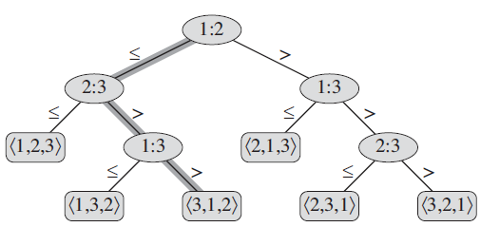
Decision-tree model
Comparison sorts can be viewed as decision trees, a full binary tree, where
  internal nodes represent comparisons,
  leaves represent the output (ordering),
  a branch from the root to a leaf represents the decisions made when sorting the input.

Slide 6
Decision-tree model
The length of the longest path = the worst case number of comparisons
How many leaves can be in a full binary tree with height h?
# leaves = 2^{h}
n!
2^{h}

Slide 7
Decision-tree model
2^{h} >= n!
n!
h >= lg(n!)
h = Ω(nlgn)
2^{h}

Slide 8
Linear time sorting algorithms
Is it possible?
Should not use comparisons. Some assumptions should apply.
Linear sorting algorithms:
  Counting sort
  Radix sort
  Bucket sort

Slide 9
Counting sort
Designed by H. Seward in 1954.
Assumes that each of n input elements is an integer in range [0,k]
When k=O(n), then it has Θ(n) time.

Slide 10


Counting sort
The idea is to determine, for each element a_{i}, the number of smaller elements so that we can put a_{i} in its correct position.
Some changes are needed to handle cases where some elements
have equal values.

Slide 11
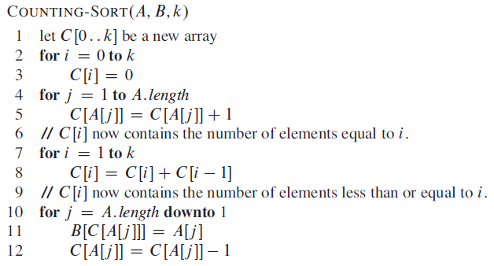
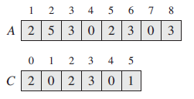

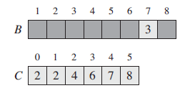
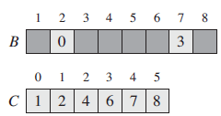


Counting sort
Uses additional arrays B and C

Slide 12
Counting sort
Θ(k)
Θ(n)
Θ(k)
Θ(n)
Time = Θ(n+k)
k = O(n) => Θ(n)
- Does not sort in place!
- Stable sort

Slide 13
Radix sort
Assumes that each element in the n-element array A has d digits.
Every digit has k values, e.g., k = 10 for decimal.
Break key into “digit” representation
  key = i_{d}, i_{d-1}, …, i₂, i₁
  "digit" can be a number in any base, a character, etc
The idea is to sort input on each digit starting from the least significant digit.

Slide 14


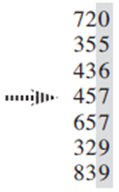
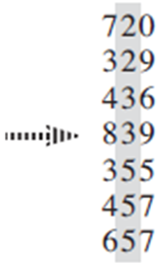
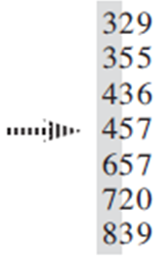
Radix sort

Slide 15
Radix sort
Time = Θ(d(n+k))

Slide 16
Radix sort
Sort 1 million 64-bit numbers.
We could use Merge sort, heapsort which would run in Θ(n lg n) in the average case.
lg 1,000,000 ≈ 20 => 20* 1000000 = 20000000

Slide 17
Radix sort
Sort 1 million 64-bit numbers.
We can treat a 64 bit number as a 4 digit, radix-2¹⁶ number. So d = 4, k = 2¹⁶ , n = 1,000,000
Θ (d (n + k )) = Θ ( 4(2¹⁶ +n)). This takes 4 * 1065536 = 4263144
16 bits
d₃
16 bits
d₂
16 bits
d₁
16 bits
d_{o}
64 bits number = d₃*(2¹⁶)³ + d₂*(2¹⁶)²⁺ d₁ (2¹⁶)¹ + d₀(2¹⁶)⁰

Slide 18

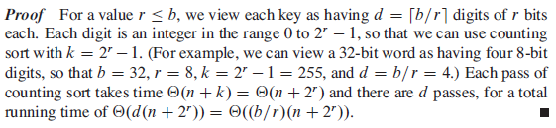
Radix sort

Slide 19
Bucket sort
Assumes that the input is uniformly distributed over the interval [0,1)
For uniform input distribution, it runs in linear time.
The idea is to
  divide the interval [0,1) into n equal-sized subintervals (buckets),
  distribute input elements into the buckets,
  sort the buckets,
  go through buckets in order

Slide 20
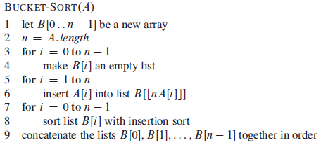
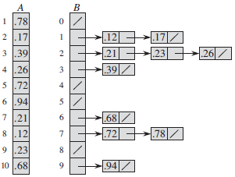
Bucket sort
Time = Θ(n)

